Slide 1

Garbage Collection

Slide 2
What is Garbage Collection?
Garbage collector is used to delete unreferenced objects from heap.
Java garbage collection is an automatic process perform by JVM.
The main objective of garbage collector is to free heap memory by destroying unreachable objects.

Slide 3
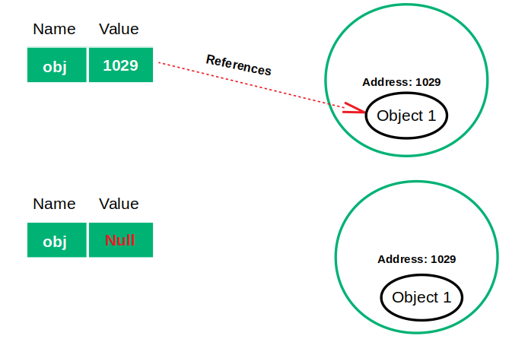
Referenced and unreferenced objects

Slide 4
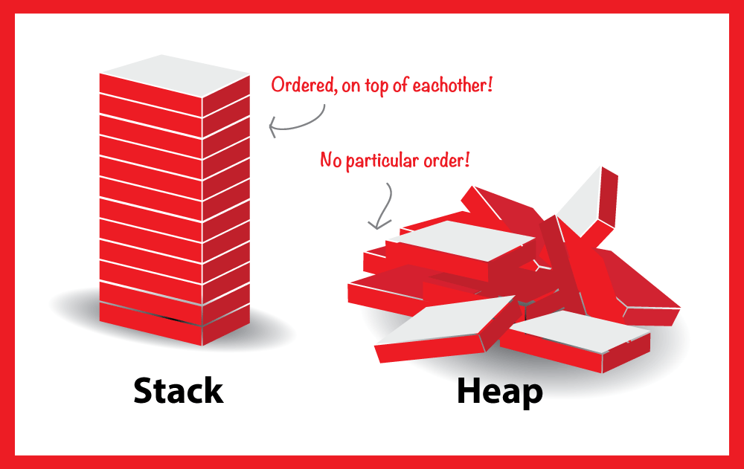

Slide 5
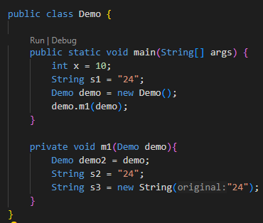
Heap
Stack
main()

Slide 6
Heap
Stack
x = 10
main()

Slide 7
Heap
Stack
SCP
24
s1
x = 10
main()

Slide 8
Heap
Stack
SCP
24
demo
demo
s1
x = 10
main()

Slide 9
Heap
Stack
SCP
24
m1
demo
demo
s1
x = 10
main()

Slide 10
Heap
Stack
SCP
24
demo2
m1
demo
demo
s1
x = 10
main()

Slide 11
Heap
Stack
SCP
24
s2
demo2
m1
demo
demo
s1
x = 10
main()

Slide 12
Heap
Stack
SCP
s3
24
s2
demo2
m1
24
demo
demo
s1
x = 10
main()

Slide 13
Heap
Stack
SCP
24
24
demo

Slide 14
Heap Memory
S1
S0
Survival
Eden
Survival
Young generation
Old generation

Slide 15
GC algorithm

Slide 16
Suppose we create an object o1, o2, o3, o4, o5
Eden
S0
S1
o1
o1
o2
o3
o4
o5
Young generation

Slide 17
Consider o2 and o5 are unreferenced object
Eden
S0
S1
o1
o1
o2
o3
o4
o5
Young generation

Slide 18
Unreferenced object are removed and referenced object moved to S0
Eden
S0
S1
1
1
o1
o3
1
o4
Young generation

Slide 19
If we again create object o6, o7, o8
Eden
S0
S1
1
1
o6
o7
o1
o3
1
o8
o4
Young generation

Slide 20
Suppose here o7,o8 and o3 are unreferenced object
Eden
S0
S1
1
1
o6
o7
o1
o3
1
o8
o4
Young generation

Slide 21
Gc will remove unreferenced object and move all live object in S1
Eden
S0
S1
2
1
o1
o6
2
o4
Young generation

Slide 22
Suppose we again create object of o9 and o10
Eden
S0
S1
2
1
o9
o1
o6
2
o10
o4
Young generation

Slide 23
Suppose o9 and o1 are unreferenced object
Eden
S0
S1
2
1
o9
o1
o6
2
o10
o4
Young generation

Slide 24
Gc will remove unreferenced object and move referenced object to S0
Eden
S0
S1
3
1
o4
o10
2
o6
Young generation

Slide 25
This process is called as Minor GC.
Now suppose the threshold of object here is 3.
Eden
S0
S1
3
1
o4
o10
2
o6
Young generation

Slide 26
4
o4
Old generation
Promoted
Eden
S0
S1
2
o10
3
o6
Young generation

Slide 27
4
o4
Old generation
When GC runs in old generation it is called as Major GC.
Objects present in old generation are used frequently and alive from too long.
GC in old generation is little bit time taking than young generation.

Slide 28
How can we make objects eligible for GC?
Nullifying the reference variable
Student s1 = new Student();
Student s2 = new Student();
s1
s2

Slide 29
Nullifying the reference variable
This object is eligible for GC
Student s1 = new Student();
Student s2 = new Student();
s1 = null;
s1
s2

Slide 30
2. Reassigning the reference variable
Student s1 = new Student();
Student s2 = new Student();
s1
s2

Slide 31
2. Reassigning the reference variable
This object is eligible for GC
Student s1 = new Student();
Student s2 = new Student();
s1 = new Student();
s1
s2

Slide 32
3. Object created inside method
class Test{
public static void main(String[] args) {
m1();
}
public static void m1(){
Test t1 = new Test();
Test t2 = new Test();
}
}
t1
t2

Slide 33
Request JVM to run GC
System.gc();
Runtime r = Runtime.getRuntime();
Even if we write this in our code, JVM has control when to run garbage collector so garbage collector may or may not be activated

Slide 34
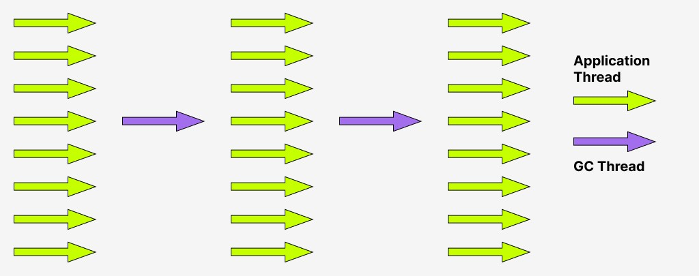
Types of Garbage Collector
Serial Garbage Collector

Slide 35
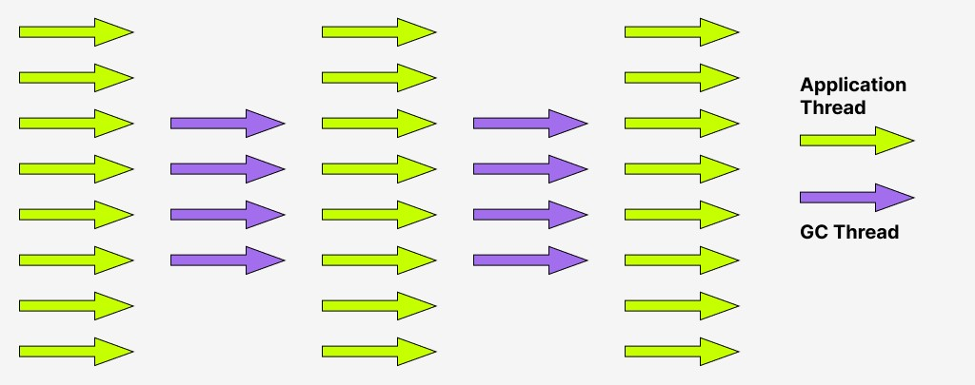
Parallel Garbage Collector

Slide 36
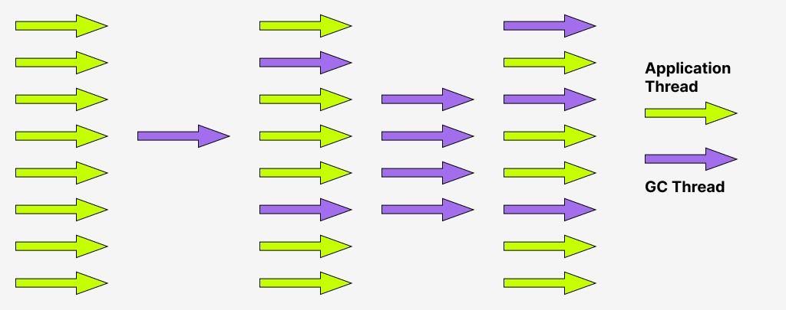
Concurrent Mark Sweep GC

Slide 37
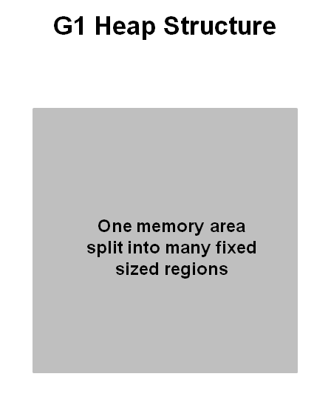
G1GC
Region size is chosen by JVM at startup.
The JVM generally targets around 2000 regions varying in size from 1Mb to 32 Mb.

Slide 38
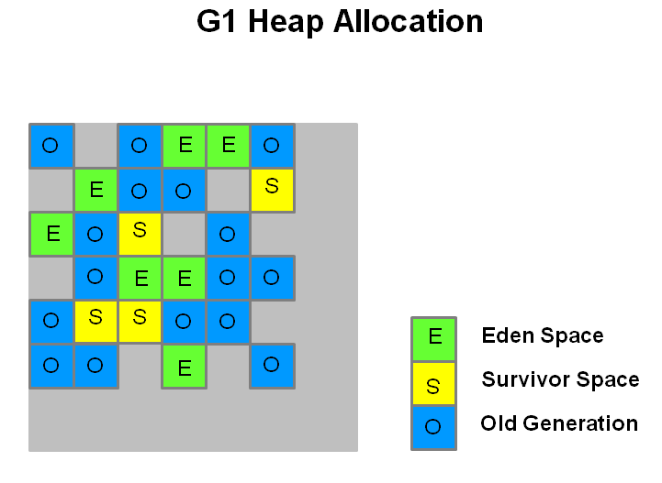
G1GC
Live objects are copied or moved from one region to another.
Regions are designed to be collected in parallel with or without stopping all other application threads.

Slide 39
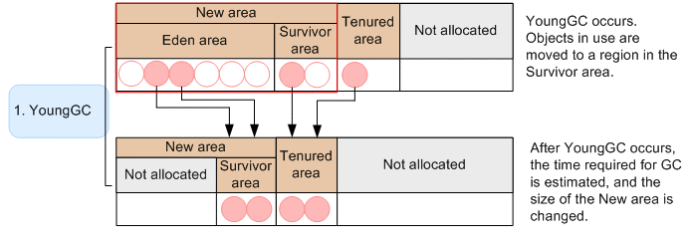
G1GC
Young GC occurs when there is no more space in a region allocated to New area. This is the stop the world pause.
If the GC took longer than expected, G1 may reduce the size of the New area to prevent future delays. Conversely, if the GC was fast, the New area size might increase.

Slide 40
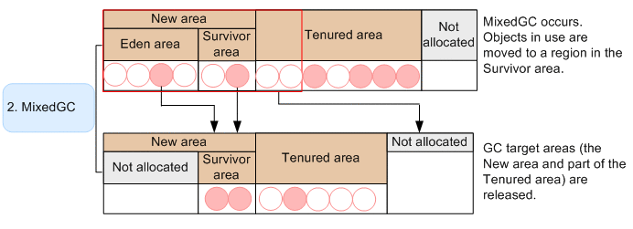
G1GC
Mixed GC occurs when the usage rate of the Tenured area increases.
If the analysis of object information in the Tenured area is insufficient, or if the potential impact of the Mixed GC is minimal, the G1 GC may skip this phase.

Slide 41
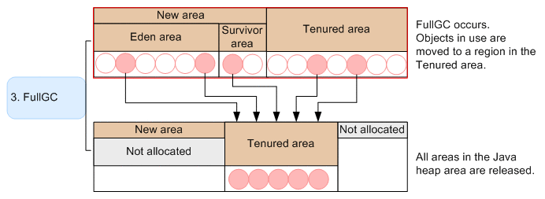
G1GC
FullGC occurs for the entire heap area, when there is no space in a region in the heap area. This is stop the world event.
Full GC also includes heap compaction. G1 GC tries to avoid Full GCs as much as possible, but it occurs when memory pressure is high

Slide 42
ZGC
ZGC was introduced in JDK 11 and was production ready at JDK 15.
Key features:
Low latency (Pause time below 10 milliseconds )
Supports large heap
Concurrent operations
No generational concept

Slide 43
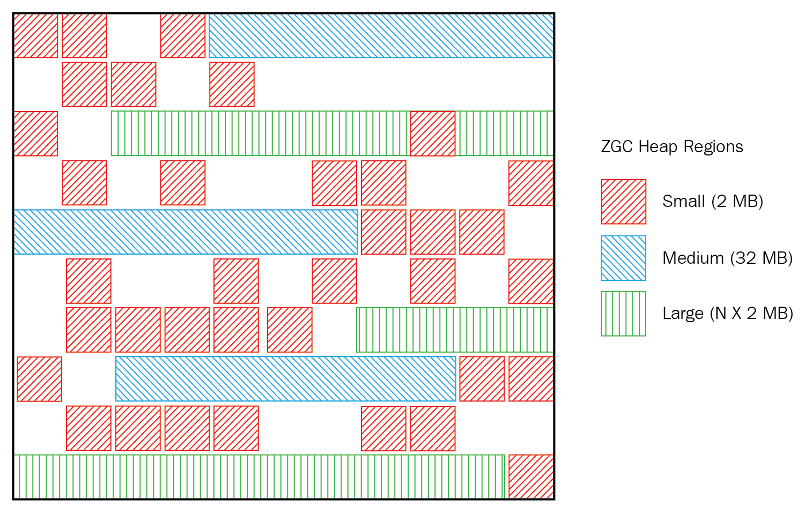
ZGC
The heap in ZGC is divided into a set of regions called pages. These pages can be of different sizes (2 MB, 32 MB, or 1 GB).
Unlike G1 GC, ZGC does not divide the heap into generations; all objects are treated uniformly.

Slide 44
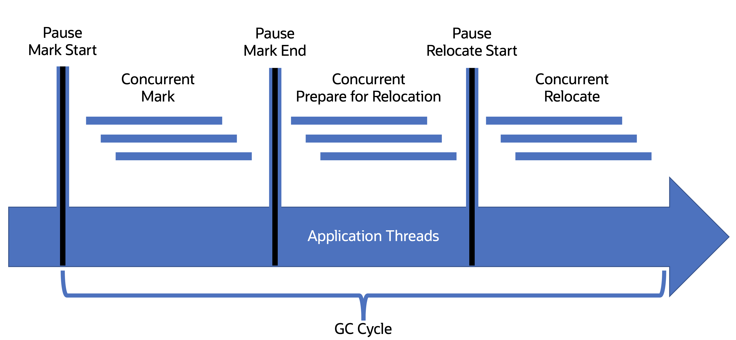
ZGC
Pause Mark Start:
This is a brief "stop-the-world" (STW) pause where ZGC marks the root objects in the heap. The application threads are paused for a very short time to start the marking phase.

Slide 45
ZGC
Concurrent Mark:
After the initial pause, the GC marking phase continues in parallel with the application threads. During this phase, ZGC identifies all live (reachable) objects by tracing from the root objects. Since this phase is concurrent, the application continues running while the marking is happening.

Slide 46
ZGC
Pause Mark End:
After concurrent marking, there’s another short pause where the GC ensures all live objects have been marked. This marks the end of the marking phase.

Slide 47
ZGC
Concurrent Prepare for Relocation:
ZGC then prepares to relocate (move) objects to combat memory fragmentation. This phase is also done concurrently with the application threads. The GC identifies which objects will be moved

Slide 48
ZGC
Pause Relocate Start:
Another brief pause occurs where ZGC transitions to the relocation phase. The application threads are paused for a moment to begin the relocation process.

Slide 49
ZGC
Concurrent Relocate:
Finally, ZGC moves the identified objects to new memory regions. Like other phases, this relocation happens concurrently, allowing the application to keep running with minimal interruption.

Slide 50
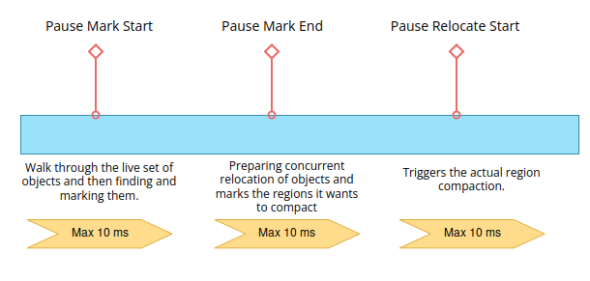
ZGC
The entire GC cycle involves marking live objects, preparing for relocation, and relocating them, but these tasks are done in a way that minimizes impact on the application's performance.

Slide 51
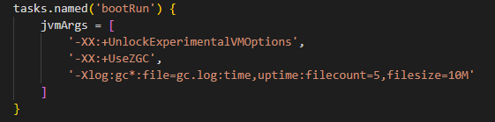
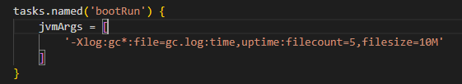
Implementation
For ZGC
For G1GC

Slide 52
Analyzing gc logs

Slide 53
THANK YOU

